Slide 1

Troy University
-International Programs-

Slide 2
Where is Troy?
Troy is a university town located in the Southeast of the United States and has a population of approximately 20,000 people.
It is 300kms away from Atlanta, Georgia, and 200kms away from the beaches of Florida.

Slide 3


Academic Programs
ESL programs
  Short-term Online (4 - weeks)
  1-year programs
Undergraduate
  2-year associate degree and
  4-year bachelor’s degree
Graduate
  Master’s degree programs
  Doctorates

Slide 4

Scholarship Opportunities
Undergraduate Admissions Scholarship
  2.0 out of 4.0 CGPA equivalent required on high school transcripts
  English proficiency test scores – TOEFL, IELTS, iTep, Duolingo, Cambridge English Test, Pearson English Test, International Baccalaureate, SAT, and ACT.
Scholarship = 50% off Tuition
50% for year 2 with 3.0 GPA

Slide 5

Estimated
Yearly Cost
 | ESL | UNDERGRADUATE | GRADUATE
Tuition + Fees | $7,500.00 | $18,500.00 | $17,000.00
Housing + Fees | $10,500.00 | $10,500.00 | $10,500.00
Estimate
Yearly total (I-20 amount) | $18,000.00 | $29,000.00 | $27,500.00
Scholarship (estimate) | $1,000 (if given) | $9,250.00 | $8,500.00
Yearly total with scholarship | $17,000 | $19,700.00 | $18,500.00

Slide 6
English Proficiency Test Scores
Test Type | Score Required Undergraduate | Score Required Graduate
IELTS | 5.5 | 6.0
TOEFL iBT | 61 | 70
TOEFL Computer Based | 173 | 193
TOEFL Paper Based | 500 | 523
SAT Reading/Writing | 480 | ---
ACT (English Section) | 20 | ---
iTep Academic | 3.5 | 4
Duolingo | 85 | 100
Cambridge English Language | 162 | 169
Pearson Test of English | 46 | 54

Slide 7


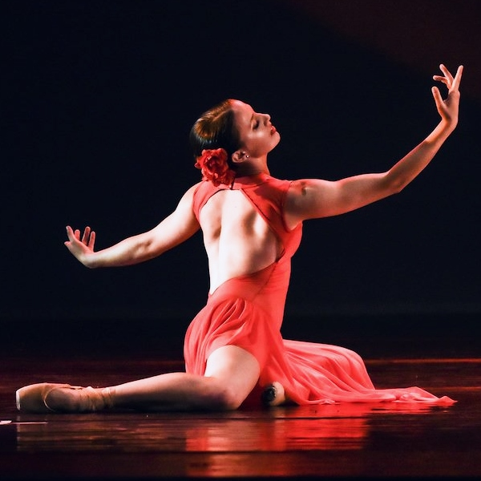
Campus Life
More than 300 social clubs and organizations
International Students Cultural Organization
New recreation center
Troy athletics
Troy intramurals
Entertainment
    Plays/theater/dance
    Speakers
    $2 movie nights
    Art exhibitions

Slide 8

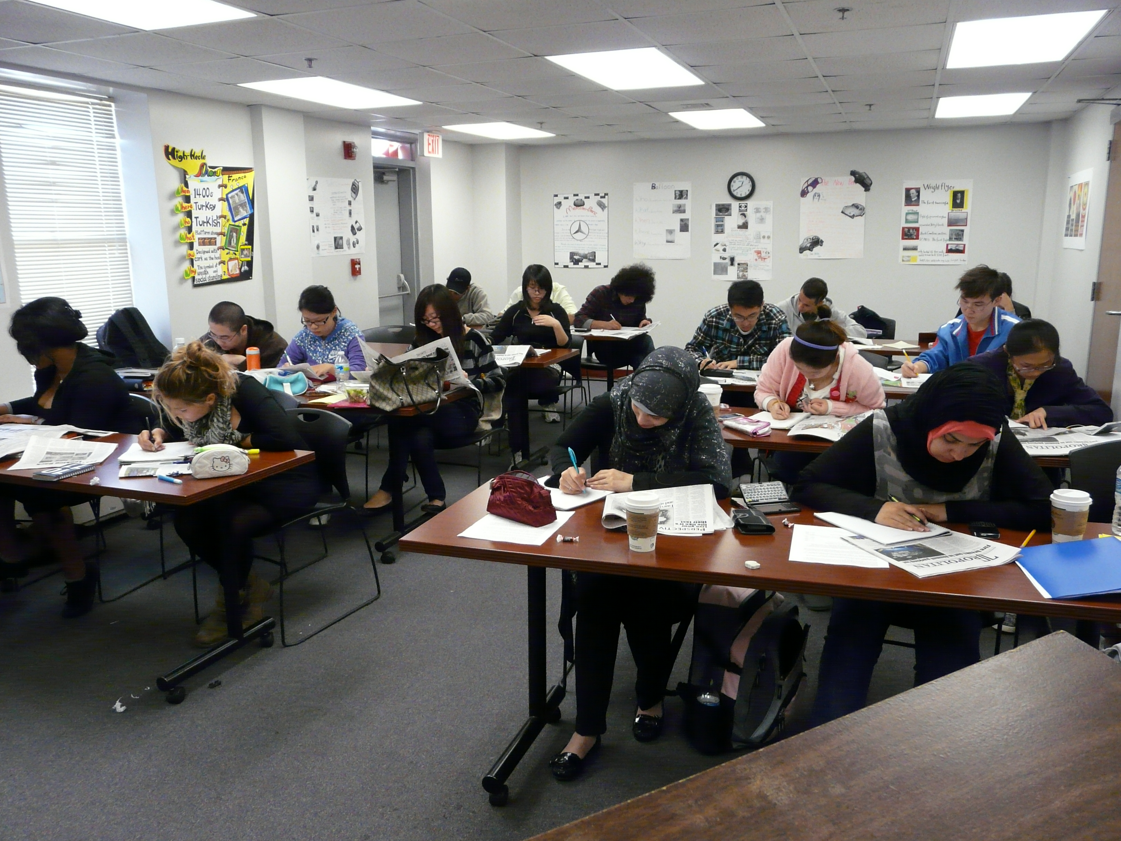
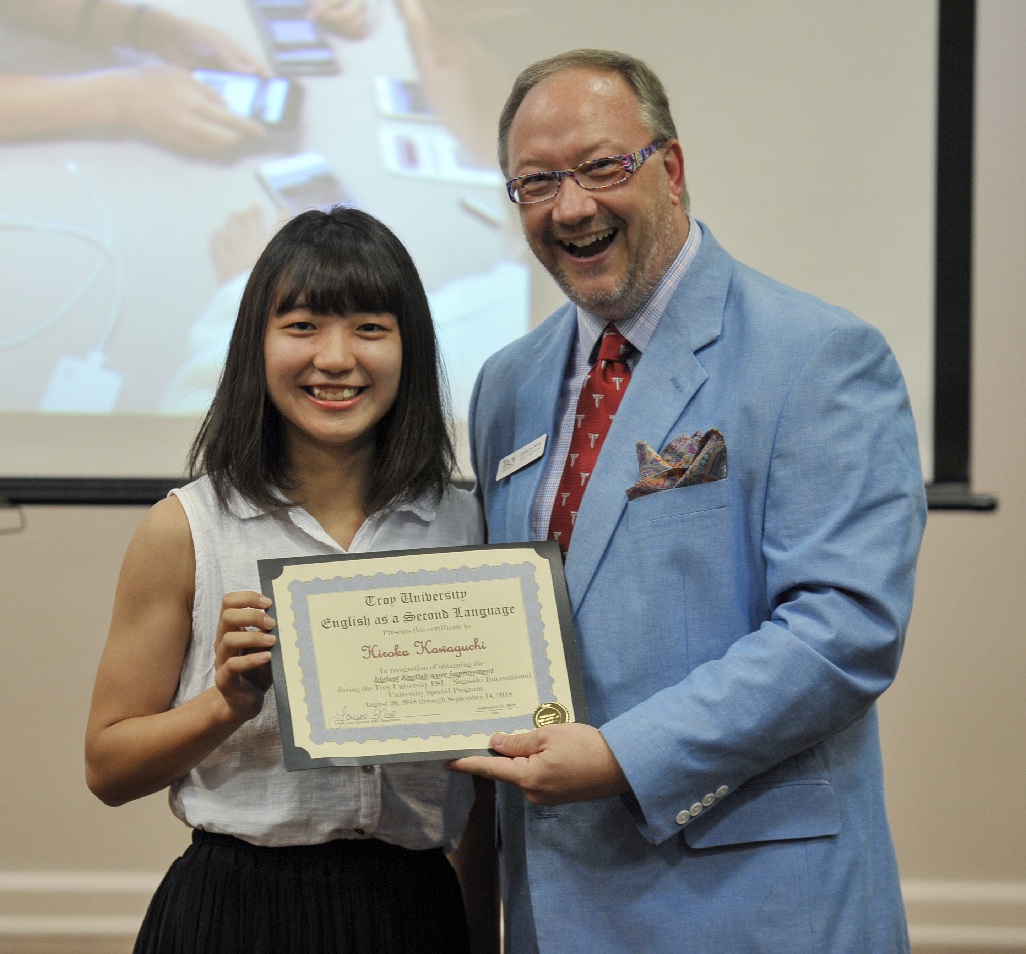
ESL Program
4 skills:
  Grammar
  Reading
  Writing
  Listening/Speaking
5 days a week
8-week terms
6 levels
  1-3 everyday English
  4-6 academic English

Slide 9
ESL Online Courses
Costs
Grammar
Reading
Speaking
Other
Grammar 1 - Beginners
Grammar 2 - Intermediate
Grammar 3 - Advanced
Reading 1 – Beginner
Reading 2 – Intermediate
Summarizing /Paraphrasing/Outlining - Advanced
1 class = $100 USD
2 classes = $175 USD
3 classes = $225 USD
4 classes = $275 USD (Save $125)
Vocabulary Builder
Pronunciation
Listen & Speak Like a Native
Speak to me!
English Medley – weird and strange things about English
English Test Prep – IELTS or Duolingo
Specialty classes for Groups of 15+
Writing
Listening
Writing 1 – Sentences & paragraphs
Writing 2 – Essays
Writing 3 - Research
Listening 2 – Intermediate
Listening 3 – Advanced

Slide 10

Contact Information
Lance Noe – lnoe@troy.edu

